Slide 1

Put off your procrastination habit
Brandon Kim, Sylvia Wu, Echo Zhang, Ashley Zhou

Slide 2
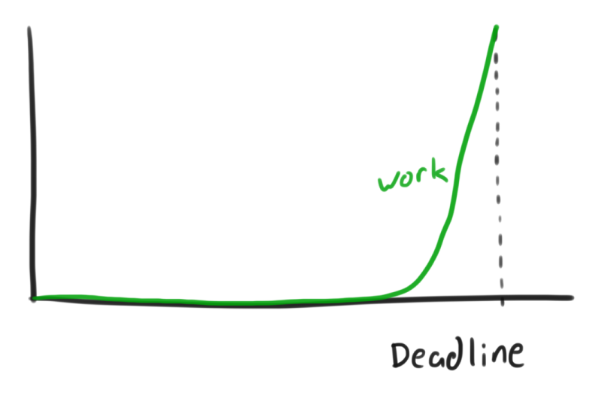
Overall Problem
Procrastination: voluntarily delaying a task knowing it is not helpful to do so
Procrastination can have many negative impacts on your life
It is a habitual behavior that needs to be corrected over time
Procrastinators need a way to track what they need to do and encourage them to finish it on time

Slide 3
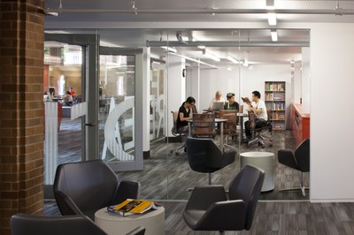
Design Research - Interview
Participants - 3
Non-procrastinator
Low-procrastinator
High-procrastinator

Slide 4
Key Findings
Can’t start on tasks
Don’t know how/where to start
Struggling with things that don’t have deadlines
Social events, self-achieving, non-required goals
Regular planner is not enough
Just an organizing method
High-procrastinators have problems following the plan
Notes:
Echo

Slide 5
Tasks
Keep Track of The Schedule And What You Finished
Finding a Reward to motivate starting a project
Attend to Necessary Goals/Projects in Order of Pleasantness
Remembering What You Should Do
Daily Reflection: How You Feel About What You Accomplished
Identifying Smaller Goals

Slide 6
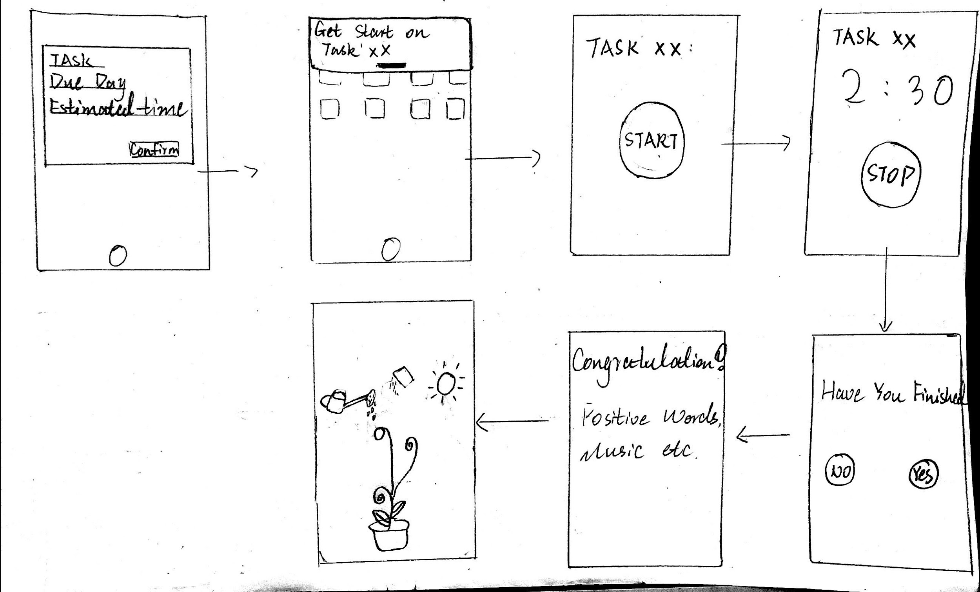
Design Sketch - 1 - Mobile Application

Slide 7
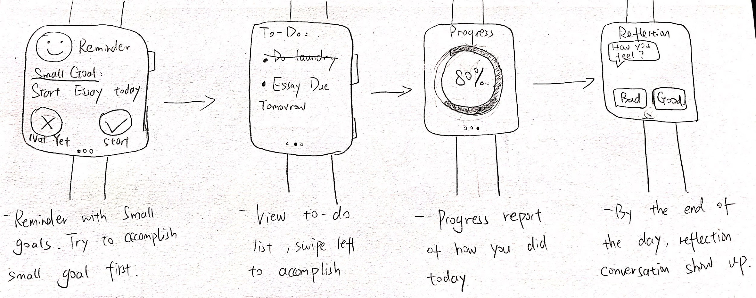
Design Sketch - 2 - Smart Watch Application
Notes:
Echo

Slide 8
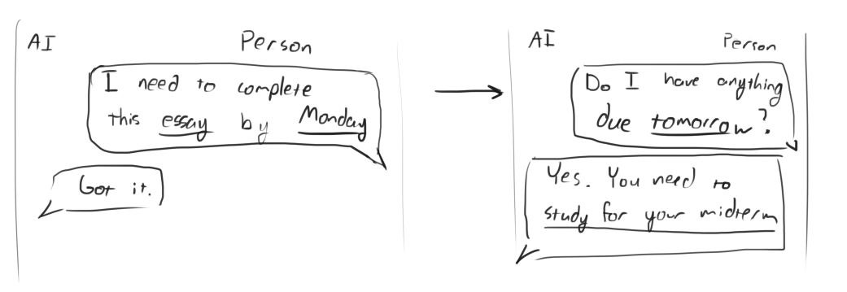
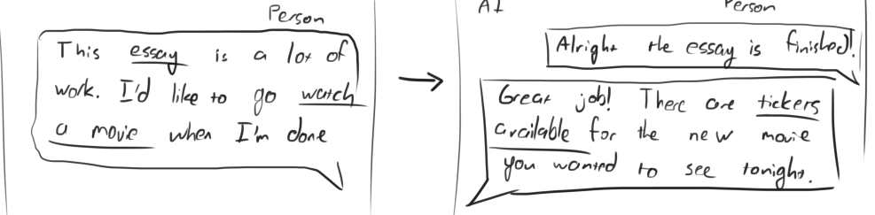
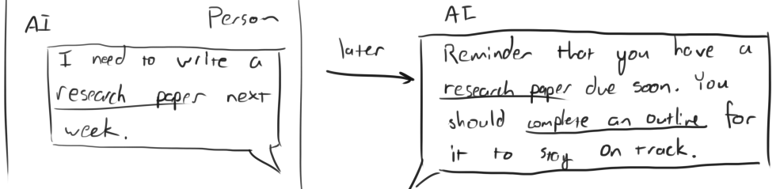
Design Sketch - 3 - Conversational Interface
Notes:
The goal of this design was to explore a newer form factor, and take advantage of the very natural way people can use voice interfaces to easily do fixed tasks and query for informaiton.

Slide 9
Design We Selected - Smart Watch Application
Best Portability
Carried around more easy than phone
Less Distraction from phone
Tasks
Choose the “easiest” task among a list
Make goals more manageable

Slide 10
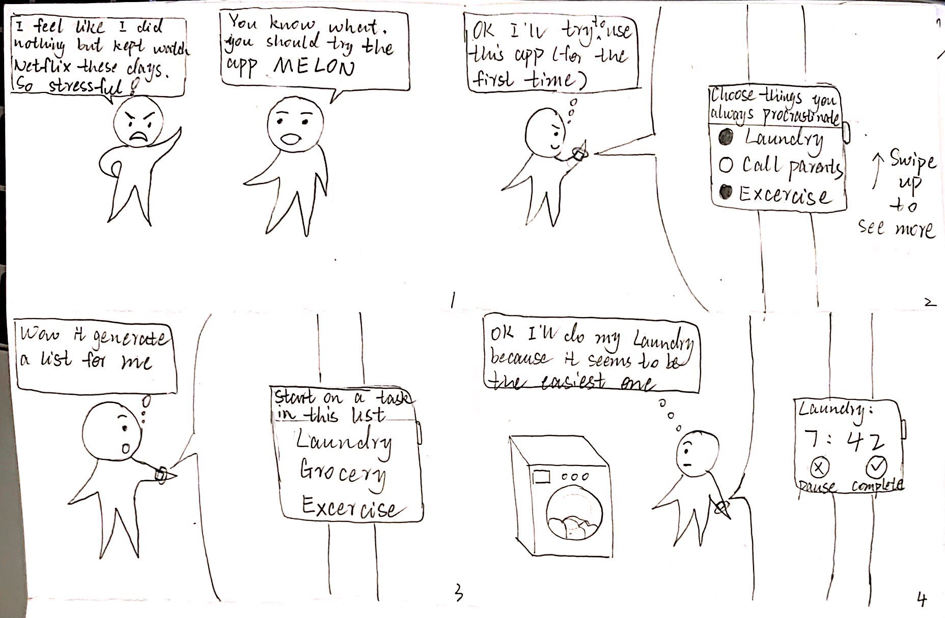
Storyboard - 1 - Choose the “Easiest” Task Among a List

Slide 11
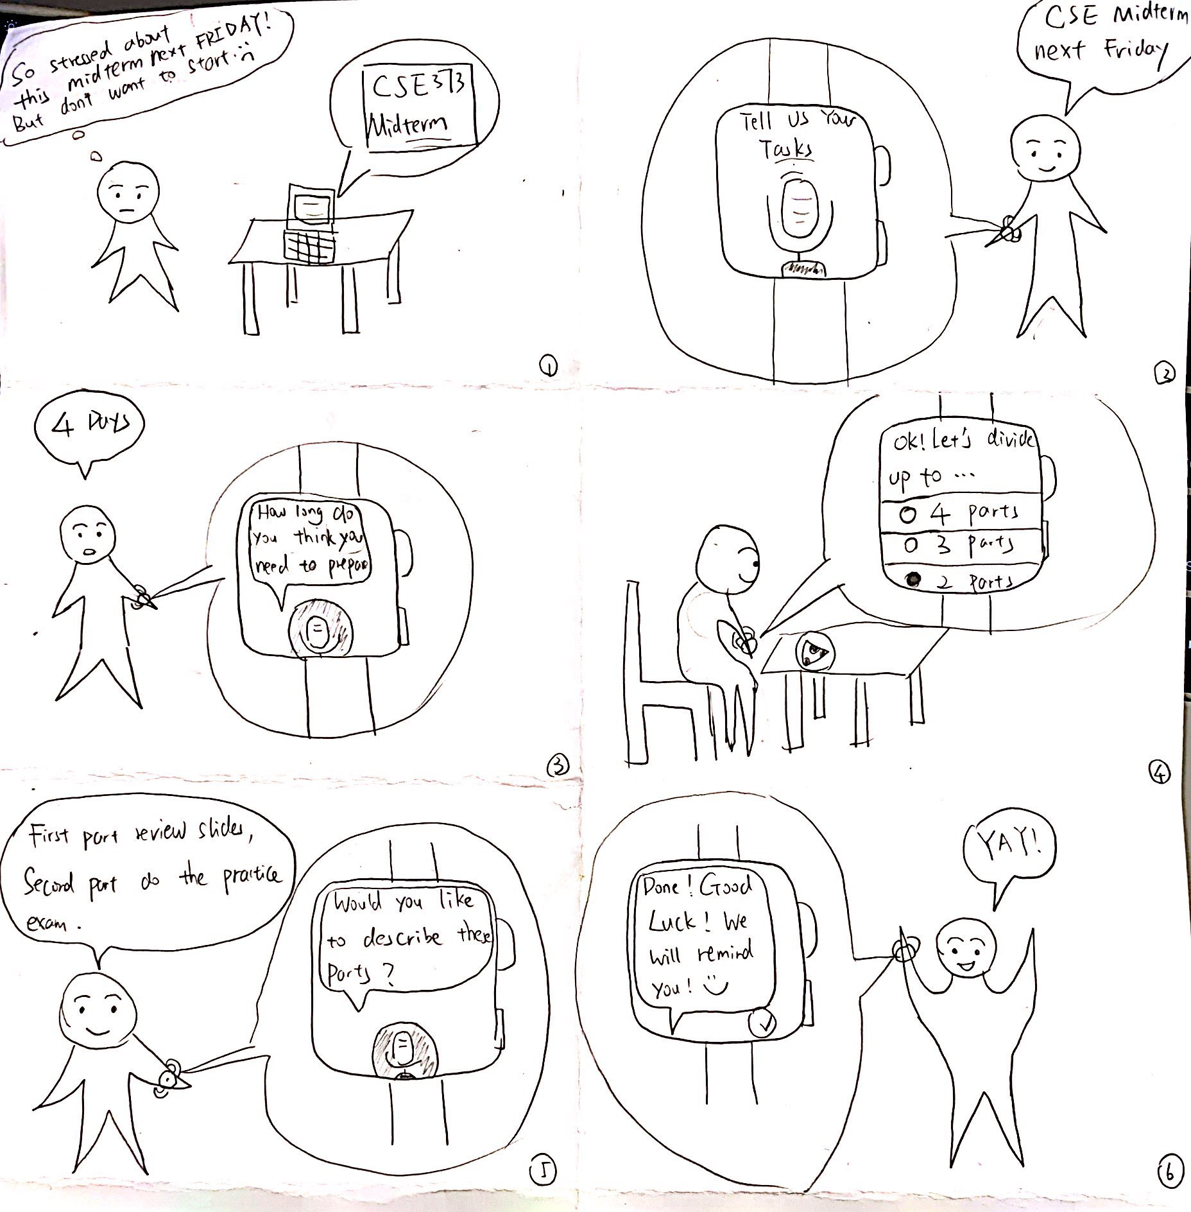
Storyboard - 2 - Make Goals More Manageable
Notes:
Echo

Slide 12
Summary
Audience can be smaller scope.
Think broad, explore new platforms and unique features.
A unique device can provide many possibilities for us to explore.

Slide 13
Thank You

Slide 14
Contribution Statement:
Brandon Kim: 15% Slides
Sylvia Wu: 25% Logo and Slides
Echo Zhang: 30% Presentation
Ashley Zhou: 30% Presentation

